Slide 1
Transmission Media & Guided Media

Slide 2
Transmission Media
A transmission medium can be broadly defined as anything that can carry information from a source to a destination.
For example, the transmission medium for two people having a dinner conversation is the air.
In data communications, the transmission medium is usually free space, metallic cable, or fiber-optic cable.

Slide 3
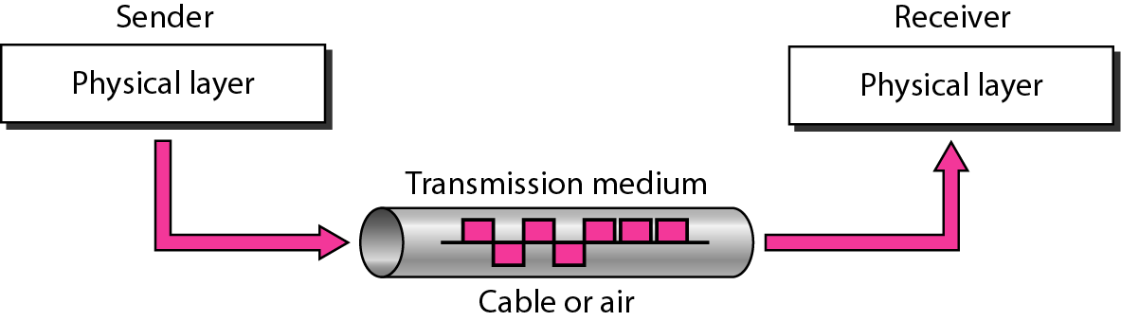
Physical Layer
The use of long-distance communication using electric signals started with the invention of the telegraph by Morse in the 19th century.
Communication by telegraph was slow and dependent on a metallic medium.
Telephone communication at that time needed a metallic medium to carry the electric signals that were the result of a conversion from the human voice.

Slide 4
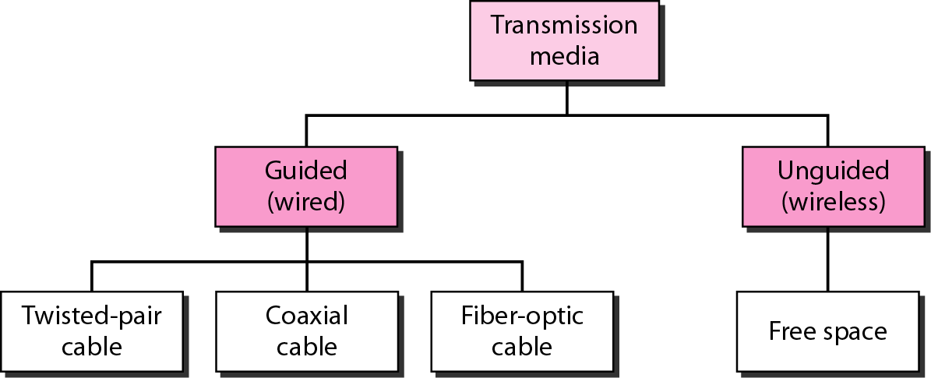
Classes of Transmission Media
In telecommunications, transmission media can be divided into two broad categories: guided and unguided.
Guided media include twisted-pair cable, coaxial cable, and fiber-optic cable.
Unguided medium is free space.

Slide 5
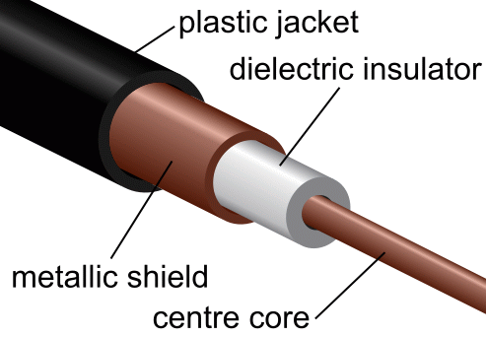
Guided Media
Guided media, which are those that provide a conduit from one device to another.
A signal travelling along any of these media is directed and contained by the physical limits of the medium.
Guided media include twisted-pair cable, coaxial cable, and fiber-optic cable.

Slide 6
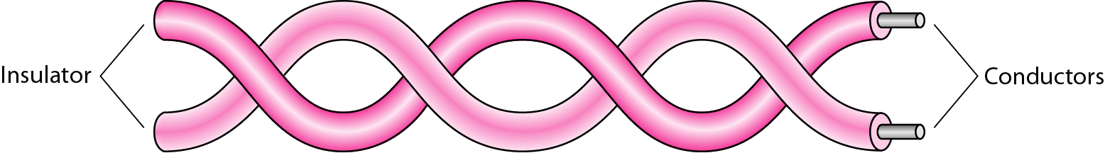
Twisted-Pair
Twisted-Pair Cable
Twisted-pair cable is the most common form of guided media used today.
Used to connect telephone subscribers to switching centres. This is known as the local loop.
The twisted-pair cable in the local loop is also used to provide high-data-rate DSL connections.
Twisted-pair cable is also used in wiring buildings for voice and data communication.
Used extensively for connecting devices in Local-Area Networks (LANs).

Slide 7
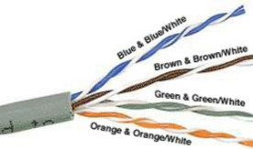
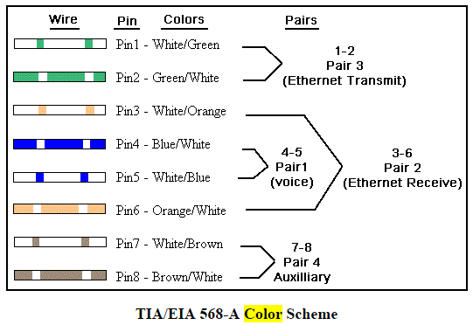
Signal Degradation in
wisted-Pair LAN Cable
Attenuation is the decrease in the power of signal over a distance in a particular type of wire or media.
Crosstalk is signal interference caused by a signal on one-pair interfering with a signal on an adjacent pair.
Noise refers to signal interference from randomly-occurring background radiation.
All are measured in dB or decibels.
Notes:
http://www.dummies.com/programming/networking/network-building-twisted-pair-cable-pinouts/

Slide 8
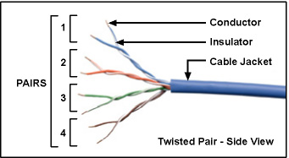
Twisted-Pair Cable
One of the wires is used to carry signals to the receiver, and the other is used only as a ground reference.
The receiver uses the difference between the two.
In addition to the signal sent by the sender on one of the wires, interference (noise) and crosstalk may affect both wires and create unwanted signals.
If the two wires were parallel, the effect of these unwanted signals would not be the same in both wires because they would be at different locations relative to the noise or crosstalk sources i.e., one would be closer and the other farther.
This would result in a difference at the receiver.
By twisting the pairs, a balance is maintained.

Slide 9
Twisted-Pair Cable
Cross-Talk Interference:
The twisting is used as a mechanism to reduce interference between pairs (crosstalk) and from outside sources.

Slide 10
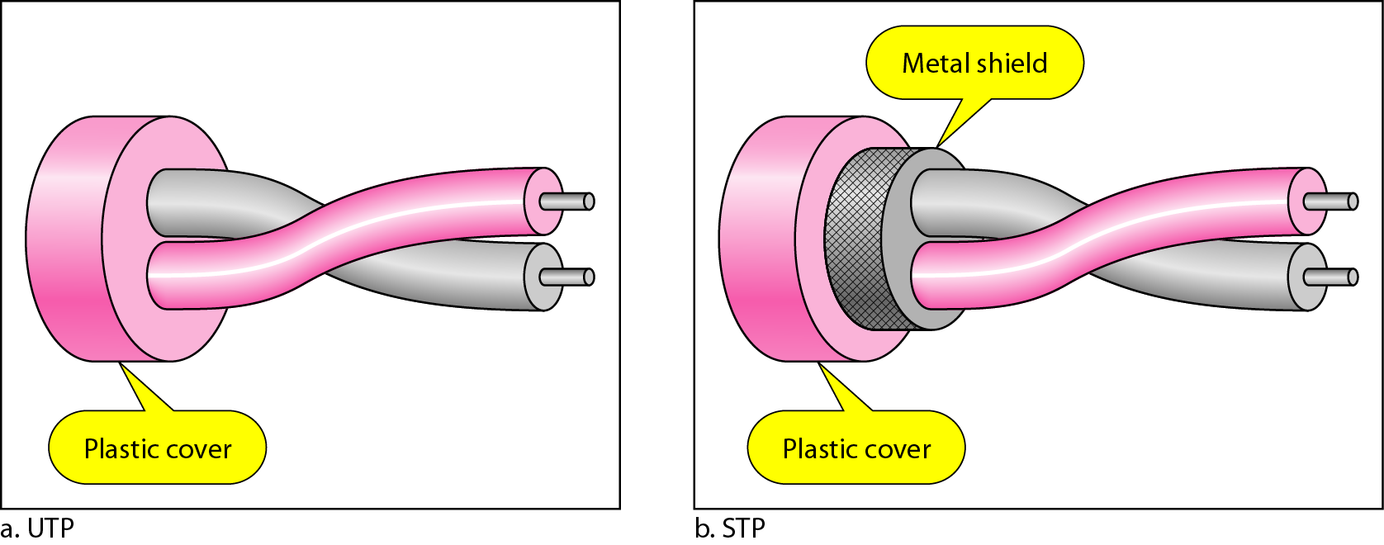
Twisted-Pair Cable
UTP (unshielded twisted pair), which is the most common form of twisted-pair cable, is a cable which has no ground shield.
Cables are often provided with a ground shield which helps to reduce signal interference from external sources.
Twisted-pair cable with a ground shield is known as STP (shielded-twisted pair) cable.

Slide 11
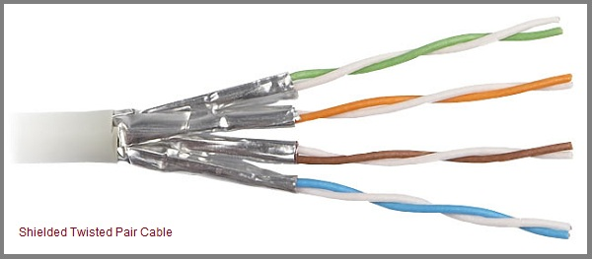
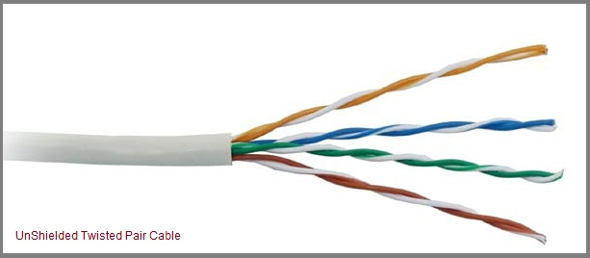
UTP and STP
The picture on the right is of STP Category 3 cable
The picture on the left is of UTP Category 5 cable

Slide 12
Categories of UTP Cables
Notes:
American wire gauge (AWG), also known as the Brown & Sharpe wire gauge, is a standardized wire gauge system used since 1857 predominantly in North America for the diameters of round, solid, nonferrous, electrically conducting wire.

Slide 13
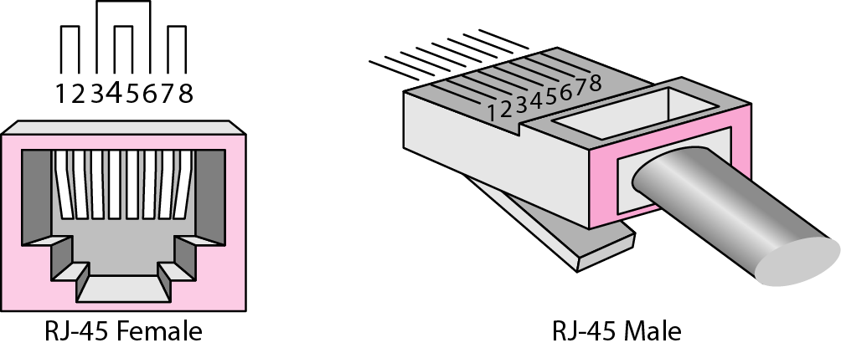
UTP Connector
Modular connectors have gender: plugs are considered to be "male," while jacks or sockets are considered to be "female," a reference to reproductive organs.
https://www.youtube.com/watch?v=98-B3JoGr_k

Slide 14
Unshielded Twisted Pair
UTP has the advantages of:
a very high installed base
cheap to install
easy to terminate (e.g., RJ-45 connector)
Some disadvantages are:
very noisy
limited in distance (100 m)
suffers from interference

Slide 15
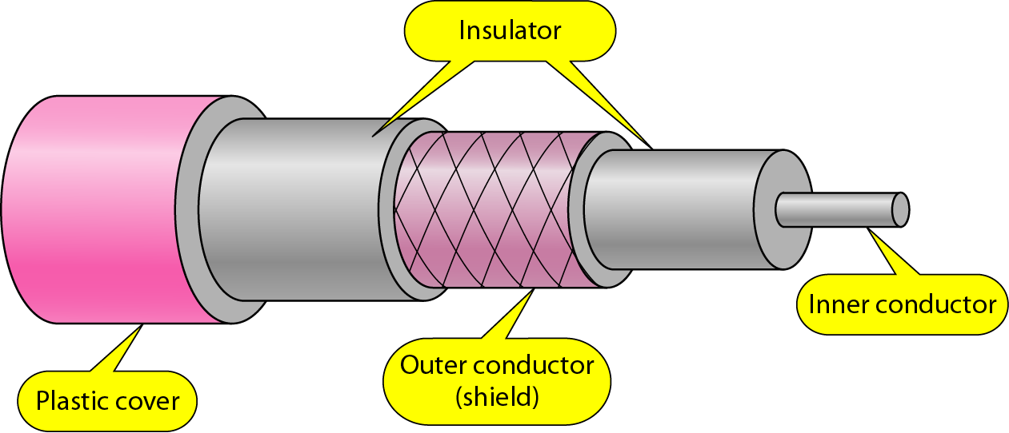
Coaxial Cable
Coaxial cable (or coax) carries signals of higher frequency ranges than those in twisted-pair cable, in part because the two media are constructed quite differently.
Instead of having two wires, coax has a central core conductor of solid or stranded wire (usually copper) enclosed in an insulating sheath.

Slide 16
Coaxial Cable
This is encased in an outer conductor of metal foil or braid.
The outer conductor serves both as a shield against noise and as the second conductor, which completes the circuit.
The outer conductor is also enclosed in an insulating sheath, and the whole cable is protected by a plastic cover.

Slide 17
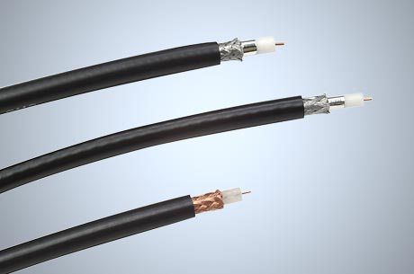
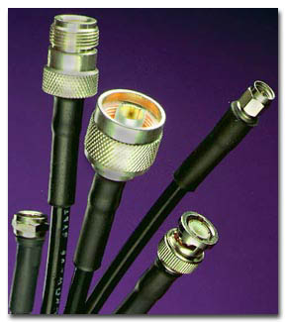
Coaxial Cable
Coaxial cable was widely used in analog telephone networks where a single coaxial network could carry 10,000 voice signals.
Later it was used in digital telephone networks where a single coaxial cable could carry digital data up to 600 Mbps.
However, coaxial cable in telephone networks has largely been replaced today with fiber-optic cable.

Slide 18
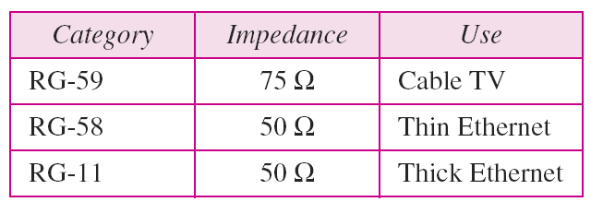
Uses of Coaxial Cable
Cable TV networks also use coaxial cables. In the traditional cable TV network, the entire network used coaxial cable.
However, more recently cable TV providers have replaced most of the media with fiber-optic cable.
These hybrid networks use coaxial cable only at the network boundaries, near the consumer premises.
Because of its high bandwidth, and consequently high data rate, coaxial cable was also used for digital transmission in early Ethernet LANs.

Slide 19
Coaxial Cable
Coaxial cable has the advantages of
relatively cheap to install compared to fibre-optics
wide bandwidth compared to twisted-pair
suitable for operation at high frequency, e.g., Cable TV
conforms to standards
still widely used but may eventually be replaced by fibre-optic cable

Slide 20
Coaxial Cable
Some of its disadvantages are:
quite bulky so it is difficult to wire
limited in distance (when compared to fibre)
limited in number of connections
terminations and connectors must be done properly
optical fiber more cost-effective for long links
UTP more cost-effective for short distance links

Slide 21
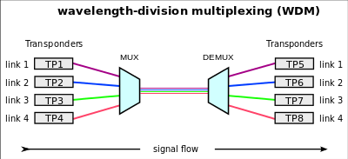
Fibre-Optic Cable
Fibre-optic cable is often found in backbone networks because its wide bandwidth is cost-effective.
When the wavelength-division multiplexing (WDM) is used with fibre optics, data transfer rates can be as high as 1600 Gbps.
Many cable TV companies use a combination of optical fiber and coaxial cable.
High-speed LANs also use fibre-optic cable.

Slide 22
Fibre-Optic Cable
Fibre-optic cable transmits data signals in the form of light.
A strand of silica glass fibre (thinner than a human hair) acts as the core of the fibre.
The core can also be made of plastic.
The core is surrounded with a cladding made of less dense glass (or plastic).
The signals are sent through the core of the fibre.

Slide 23
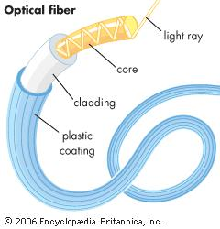
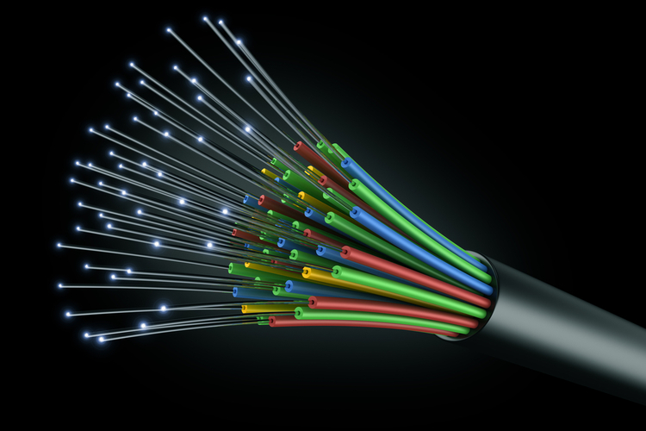
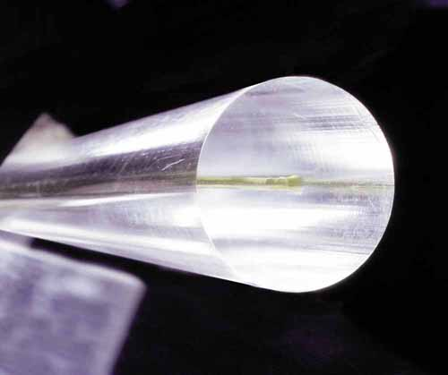
Fibre-Optic Cable

Slide 24
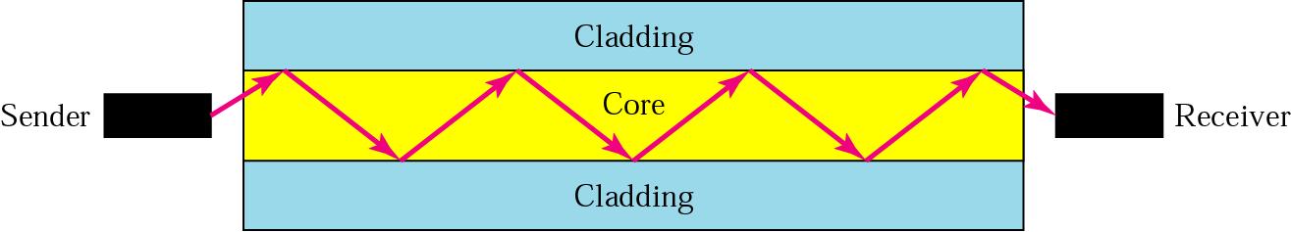
Optical Fibre
The data signals are converted to light pulses using a laser.
When the laser is shone into the strand the light travels along the fibre strand core
Light source (laser) turned on/ off for binary 1/0
Almost no attenuation or interference
So what keeps the light in the core ?

Slide 25
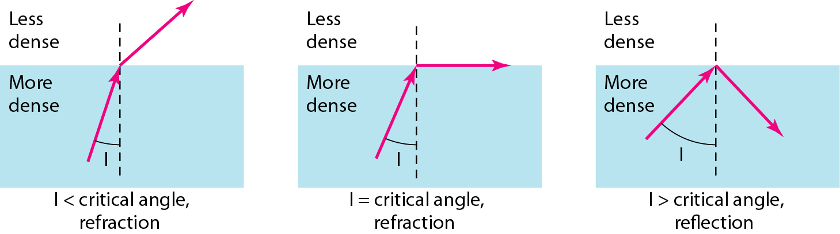
Use of Reflection
Optical fibres use reflection to guide light through core.
The glass or plastic core is surrounded by a cladding of less dense glass or plastic.
The difference in density of the two materials must be such that a beam of light moving through the core is reflected off the cladding.
So what keeps the light in the core ?
Bending of Light Ray

Slide 26
Problem with Multimode Dispersion
Limited by Distortion
Light rays entering at different angles travels different distances (different number of reflections)
Called different modes
Light from successive bits becomes mixed and dispersed over long distances causing errors in data
Light Source

Slide 27
Advantages and Disadvantages of Fibre-Optic
Some disadvantages are:
costly
fragile
difficult to join fibres
very difficult to repair fibres
difficult to go around bends
Fibre-optic cable has the advantages of:
very high capacity (bandwidth)
less signal attenuation
immune to interference
long distances (> 50 km without repeaters)

